Slide 1
Software Engineering Principles
1
CASE Tools and their Effect on
Software Quality

Slide 2
Introduction
2
There are lots of automated tools to assist in software engineering.
Their purpose is to make the work of software development and maintenance easier and more reliable.
CASE is Computer Aided Software Engineering.

Slide 3
Introduction
3
Case tools offer us (from book)
  Substantial savings in resources required for software development
  Shorter time to market
  Substantial savings in resources for maintenance
  Greater reuse due to increased standardization of the software systems, and
  Reduced generation of defects coupled with increased ‘interactive’ identification of defects during development
It is the last one that is most concerned with SQA.

Slide 4
We will address CASE and its Contributions
4
What is a CASE tool?
The contribution of CASE tools to software product quality
The contribution of CASE tools to software maintenance quality
The contribution of CASE tools to improved project management

Slide 5
5
CASE Tools - Definition
CASE tools are computerized software development tools that support the developer when performing one or more phases of the software life cycle and/or support software maintenance.

Slide 6
CASE Tools
6
Must distinguish between ‘classic’ case tools and ‘real’ case tools.
Classic CASE tools: Interactive debuggers, compilers, project progress control systems
Real Case tools: support several phases of development
Upper CASE tools support analysis and design.
Lower CASE tools refer to the location in these phases in the Waterfall Model.
Integrated CASE tools support analysis, design, and coding.

Slide 7
CASE Tools
7
The main component of real CASE tools is the repository!
  Example: Rational Team Concert (RTC)
Repository stores all changes and info related to the project from development through maintenance.
Maintenance:
  Corrective
  Adaptive
  Functional improvements.
There is a computerized management of the repository!
The repository is the glue holding all activities together.

Slide 8
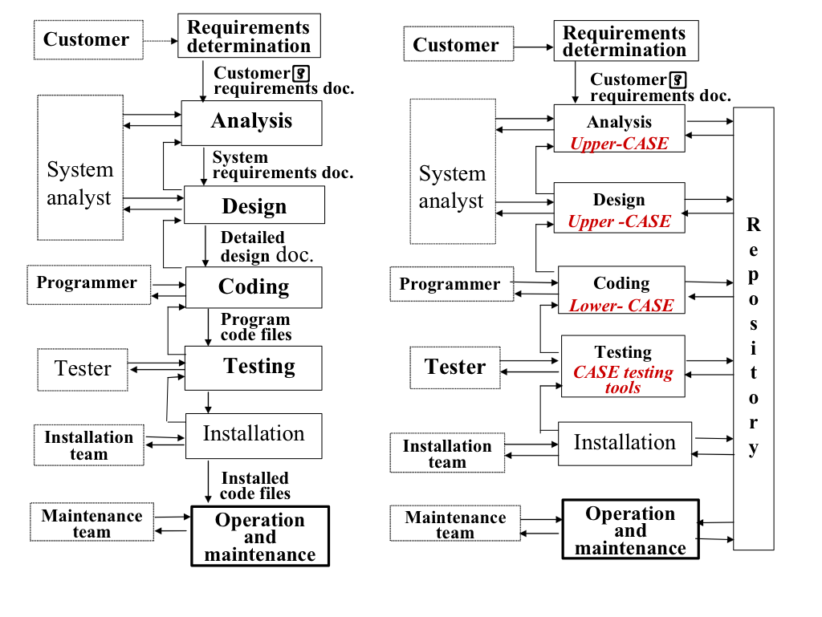
Can see comparisons and real CASE tool supports.
Note the Repository; Note the xxx-CASE tools.
8
Traditional development life cycle
Real CASE tool-supported development life cycle

Slide 9
CASE Tools
9
Some CASE tools will automatically generate code from designs stored in the repository.
  Example: Rational Rose and others; often based on a design model and parameters supplied….
Some CASE tools provide for ‘reverse engineering’
  These are used to recover and/or replicate design documents from running, well-established (legacy) software systems.
  These tools may create completed updated repository and design documents based on the code.

Slide 10
Can see comparisons and real CASE tool supports.
Note the Repository; Note the xxx-CASE tools.
10
Traditional development life cycle
Real CASE tool-supported development life cycle

Slide 11
CASE Tool Support
11
Type of CASE tool
Support Provided
Editing and Diagramming
Repository Query
Automated Documentation
Design Support
Editing text and diagrams, generating design diagrams to repository records
Display of parts of the design texts, charts, etc.; cross referencing queries and requirements tracing
Automatic generation of requested documentation according to updated repository records
Editing design recorded by the systems analyst and management of the data dictionary

Slide 12
CASE Tool Support
12
Type of CASE tool
Support Provided
Code Editing
Code Generation
Configuration Management
Compiling, interpreting or applying interactive debugging code specific coding language or development tool
Transformation of design records into prototypes or application software compatible with a given software development language (or development tools)
Management of design documents and software code versions, control of changes and software code.

Slide 13
CASE Tool Support
13
Type of CASE tool
Support Provided
Reverse Engineering (re-engineering)
Project Management and Software Metrics
Construction of a software repository and design documents, based on code: the “legacy” software systems. Once the repository of the legacy software is available, it can be updated and used to automatically generate new versions of the system. As new re-engineering software version is generated, it can be easily maintained and its documentation automatically updated.
Support progress control of software development projects by follow-up of schedules and calculation of productivity and defects metrics

Slide 14
Contribution of CASE
Tools to Software Product Quality
14
Simply stated, CASE tools can signification contribute to a reduction of errors in each development phase. Consider some of the tools you use
Extent of
contribution to quality
Cause of software errors | Classic CASE tools | Real CASE tools
1. Faulty requirements definition | None | Almost none
2. Client-developer communication failures | None | Almost none
3. Deliberate deviations from software requirements | None | High
4. Logical design errors | None | High
5. Coding errors | Very high | Very high
6. Non-compliance with coding and documentation instructions | Limited | Very high
7. Shortcomings in the testing process | High | High
8. User interface and procedural errors | High | Limited
9. Documentation errors | Limited | High

Slide 15

15
Note that most of the contributions are not addressing faulty requirements definition – (this likely with poor requirements management) are the most frequent causes of software failures.
But most of the contributions are in traceability based on data in the repository and tracing tools.
Great contribution in discovering
  design errors
  coding errors
  testing
  documentation!

Slide 16
16
Contribution of CASE tools to Software Maintenance Quality
Essentially three kinds of maintenance:
  Corrective
  Adaptive, and
  Functional Improvement Maintenance
  (next three slides)

Slide 17
17
Contribution of CASE tools to
Software Maintenance Quality
To Corrective Maintenance: (Errors)
* CASE-generated updated documentation enables easier and more reliable identification of software failure causes.
* Cross-referenced queries enable better anticipation effects of proposed correction.
* Correction by means of lower CASE or integrated CASE tools provides automated coding and documentation of corrections.

Slide 18
18
Contribution of CASE tools to
Software Maintenance Quality
To adaptive maintenance:
Full and updated documentation by CASE tools enables thorough examination of possible software adaptations for new applications.

Slide 19
19
Contribution of CASE tools to
Software Maintenance Quality
To functional improvement maintenance:
* Use of the repository assures consistency of new applications and improvements with existing software systems.
* Cross-referenced repository queries enable better planning of changes and additions.
* Changes and additions carried out by means of lower CASE or integrated CASE tools enable automated coding and documentation of the changes and additions.

Slide 20
Contribution of CASE Tools for Improved Project Management
20
There is little question that projects supported by CASE tools can have dramatic positive impacts on Project Management.
With a central repository, so many activities are integrated.
  Example: ClearCase, ClearQuest, ReqPro, … now integrated in RTC
CASEtoos can reduce the project budgets and development time
But from a quality perspective, we are interested in improvements in budget control and timetables.
CASE tools can significantly contribute from deviations of budget and schedule from a plan and the reduction of high error rates and shorter correction cycles when needed..

Slide 21
CASE tools: Advantages
21
Help standardization of notations and diagrams
Help communication between development team members
Automatically check the quality of the A&D models
Reduction of time and effort
Enhance reuse of models or models’ components

Slide 22
CASE tools: Disadvantages
22
Limitations in flexibility of documentation
May lead to restriction to the tool’s capabilities
Major danger: completeness and syntactic correctness does NOT mean compliance with requirements
Costs associated with the use of the tool: purchase + training

